Slide 1
Getting Started with Digital Literacy
Exploring useful tools to stay ahead in school
by Anthony Spezzano
AIDE Canada
Notes:
Hey, good morning and welcome everyone! Happy to be here today and let us give a huge welcome to all your viewers and the organizers for today’s event.
We’re going to get started in just a moment but I wanted to introduce myself --
I’m Anthony Spezzano and I’ll be your host, bringing you a little introduction into Getting Started with Digital Literacy: Exploring useful tools to stay ahead in school. Please, if you have any questions at all, feel free to raise them by messaging the chat box so we can go over them during Q&A near the end.

Slide 2
Making Sense of Information
An accumulation of rich sources can lead to effective solutions
Environments can empower us
Learning to utilize our surroundings and immediate accesses to build out a portfolio of strategic opportunities. Relocate, reimagine, and reframe our approach to where we see ourselves to work our best.
Exclusion is by design
Our minds are not the problem and the system appears to haven’t been built with everyone in mind. Our contributions toward our success must be proactive and will lead to long term gain built by accessibility.
A narrow focus leads to sequential success
Thinking small doesn’t limit our potential and can maximize our output. Allocating our abilities in a singular approach can create efficiencies that compound from one task to the next.
Communities are built to be relied on
We are not alone in this endeavour and many people are equally going through a similar experience. We can gain insights into our unique journey by learning how others approached their milestones.
Notes:
During my undergrad I was widely fascinated with Cognitive Science, stress management, and the human nuances that went into decision making.
Over time we build up this external brain which is this digital archive of essentially everything we read, watch, or listen to that resonates with us. Only over time, and explicitly exercising this habit, do we learn to effectively control what goes into our system and can use that additional brain to organize these ideas and thoughts to ultimately convert them into our creative outputs.
We’ll go over some fundamental principles to maximize our digital literacy.
Leveraging our passions, interests, and curiosities for our future selves to take advantage of
Borrowed Creativity -- Ideas are rarely original and usually compounding or inspired by something else.
Capture Habit -- Brains are meant for having ideas, not storing them.
Idea Recycling -- Ideas are not single use.
Slow Burns vs Heavy Lifts -- Skillful contributions over time chip away at a long term goal vs cramming in the details exhausting oneself.

Slide 3
Executive Dysfunction
Learning to identify my obstacles and accommodate my strengths.
Impulse Control
Emotional Control
The ability to think before acting.
Keeping feelings in check.
Flexible Thinking
Working Memory
Adjusting to the unexpected.
Keeping key information in mind.
Self-Monitoring
Planning and Prioritizing
Evaluate how we’re doing.
Setting goals and a plan to meet them.
Task Initiation
Organization
Take action towards getting started.
Keep track of things physically and mentally.
Notes:
Part of the problem is that habits that we are widely taught to learn in academia (at least I was) are often the ones with little evidence based support. On the topic of revision techniques such as highlighting notes, rereading content, etc I found myself at a great disadvantage to my peers and colleagues in university. Not only did I not know quite HOW to study, (and found it widely ineffective for my tastes) but I was needing to accommodate the unique nuances that comes along with having a different abilities.
Through many of the resources we’ll talk about just briefly here today I’m hoping to emphasize the true potential in being able to combat even the smallest of hurdles.
In order for immediate development I had to recognize I wasn’t fantastic at everything and it would take some serious considerations about my diagnosis.

Slide 4
Quick Overview
What you’ll see here today
Note Taking
To do lists
Habit Tracking
Functional techniques for both long and short form learning.
Reframing the approach to task ordinance and compound successes.
Measurements of what’s important with awareness and stability in mind.
Effective Research
Scheduling
Learning to find resources to help you succeed and tools that work for you.
Time management and calendar blocking around task ordinance..
Notes:
There are millions of applications in the world and half of which are paid, the others free (and of those, many with limitations until you subscribe or pay). We’re here to look at the a few applications from my experience during undergrad and what helped me excel staying ahead in school.
Keep in mind that there are more emerging technology solutions today than there were 5 years ago and it’s growing an exponential rate-- staying ahead just asks that you are willing to be curious for a little bit, every once a while.

Slide 5
Tools for Desktop and Mobile
Useful tips and tricks available for your computers and phones!
Free
Simple
We’re primarily interested in free solutions to the needs we all share.
Transparent and easy-to-use interfaces with accessibility in mind.
Connected
Optional
All the tools are synchronizable across desktop and mobile.
No one recipe exists for all this, so please be willing to tinker on.
Notes:
Basic criteria for the selection you’ll see before you today-- there are numerous feelings on what the GO TO apps are (and I’d like to believe everyone has their preference) and this is purely my experience from recent years.

Slide 6
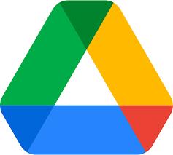
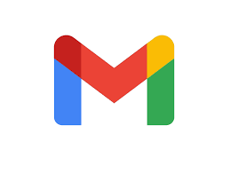

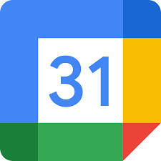

Google Apps
The easiest way to stay connected
Google Drive
Gmail
Google Keep
File management system to store and backup all your files from any device.
Minimal and streamlined email client integrated with all other Google Apps.
Quickly capture what’s on your mind and get a reminder later at the right place or time.
Google Calendar
Google Tasks
All your calendars in one place-- save time and make the most of every day.
Get more done and integrated with Gmail and Google Calendar. .
Notes:
What are Google Apps? Beyond the massively helpful search engine, Google also produces several free, simple, and very accessible applications.
You might hear these online tools referred to often as “Google Docs” but Google Docs is merely the word processor and probably just the most popular of the suite. Everyone who has a Gmail account has access to the entire online productivity suite and Google Drive Cloud Storage from either their desktops, mobile computers, or cell phones.
Seamless integration across all these apps is available out of the box-- anything from files, folders, pictures, reminders, and scheduling. One of the largest benefits of the Google App suite is that you can collaborate widely to many users, especially those who have are also Gmail users.

Slide 7
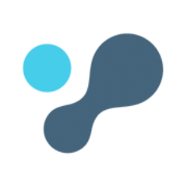
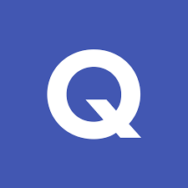
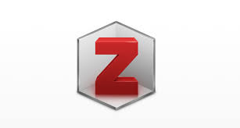
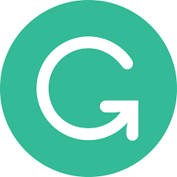
Research Essentials
Where the pen (and keyboard) proves mightier than the sword!
Quizlet
Liquid Text
Easiest way to study, practice, and master what you’re learning. From flashcards to quizzes!
Review documents faster, find facts effortlessly, and excel beyond the limits of paper.
Grammarly
Zotero
Compose bold, clear, mistake-free writing with an AI powered assistant.
Manage your readings and research diligently and cite effectively.
Notes:
Quizlet
Help every student confidently learn anything, no matter what they’re striving to achieve. Using Quizlet’s free study sets, study modes and in-class game, you can instantly create a more engaged classroom.
When it came to studying I was a mess. Now I am at this new school and they introduced me to Quizlet. I am no longer stressed when it comes to studying for assignments.
Quizlet is a great way to study. I introduced it to my friends and we are all improving. Whenever I think of Quizlet, I think of the pure joy of studying in a few minutes instead of hours.
Grammarly
The Grammarly Keyboard helps you write mistake-free and with ease in any app you use on your mobile device. It provides hundreds of checks and features, along with seamless integration. Whether you’re sending an urgent email, important LinkedIn message, or essential Facebook post, you can write from your phone with confidence.
Mistake-Free Writing
– Sophisticated grammar checker
– Contextual spelling checker
– Advanced punctuation correction
– Vocabulary enhancements
Works Everywhere
– Keyboard integrates smoothly with all apps
– Easy to set up
Improve Your Skills
– See short, clear explanations for every correction
– Helps you understand your mistakes and avoid them in the future
Liquid Text
Note-taking and document analysis tools have changed little from the margin notes, highlighting, and sticky notes we have used forever. Most apps today try to duplicate paper, but, in spite of this, over 80% of knowledge workers still prefer paper at work and school.
LiquidText moves beyond paper. It captures your reading, notes, highlights, annotations, and observations just like paper; but goes further to reveal their connections: to source materials and each other in a way that documents and maps your project in a clear and shareable form. We connect related notes into ideas, and we connect your ideas into reports.
You can import documents into Liquid Text from your files, webpage, or photos. Whichever source you choose, Liquid Text will import the content into a workspace that has two resizable columns (ie. document on the left, note space on the right though the viewing panes are customizable).
Backup and syncing services are quite new to Liquid Text as desktop variants of the application weren’t available before 2020 and are still being upgraded. While the mobile versions for iPad are robust and flushed out, you’ll have a similar experience on macOS and Windows in its current state.
Zotero
Zotero is a free, easy-to-use tool to help you
collect, organize, cite, and share research.
Zotero is the only software that automatically senses research on the web. Need an article from JSTOR or a preprint from arXiv.org? A news story from the New York Times or a book from a library? Zotero has you covered, everywhere.
Zotero helps you organize your research any way you want. You can sort items into collections and tag them with keywords. Or create saved searches that automatically fill with relevant materials as you work.

Slide 8
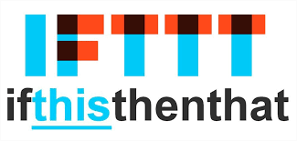
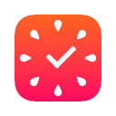
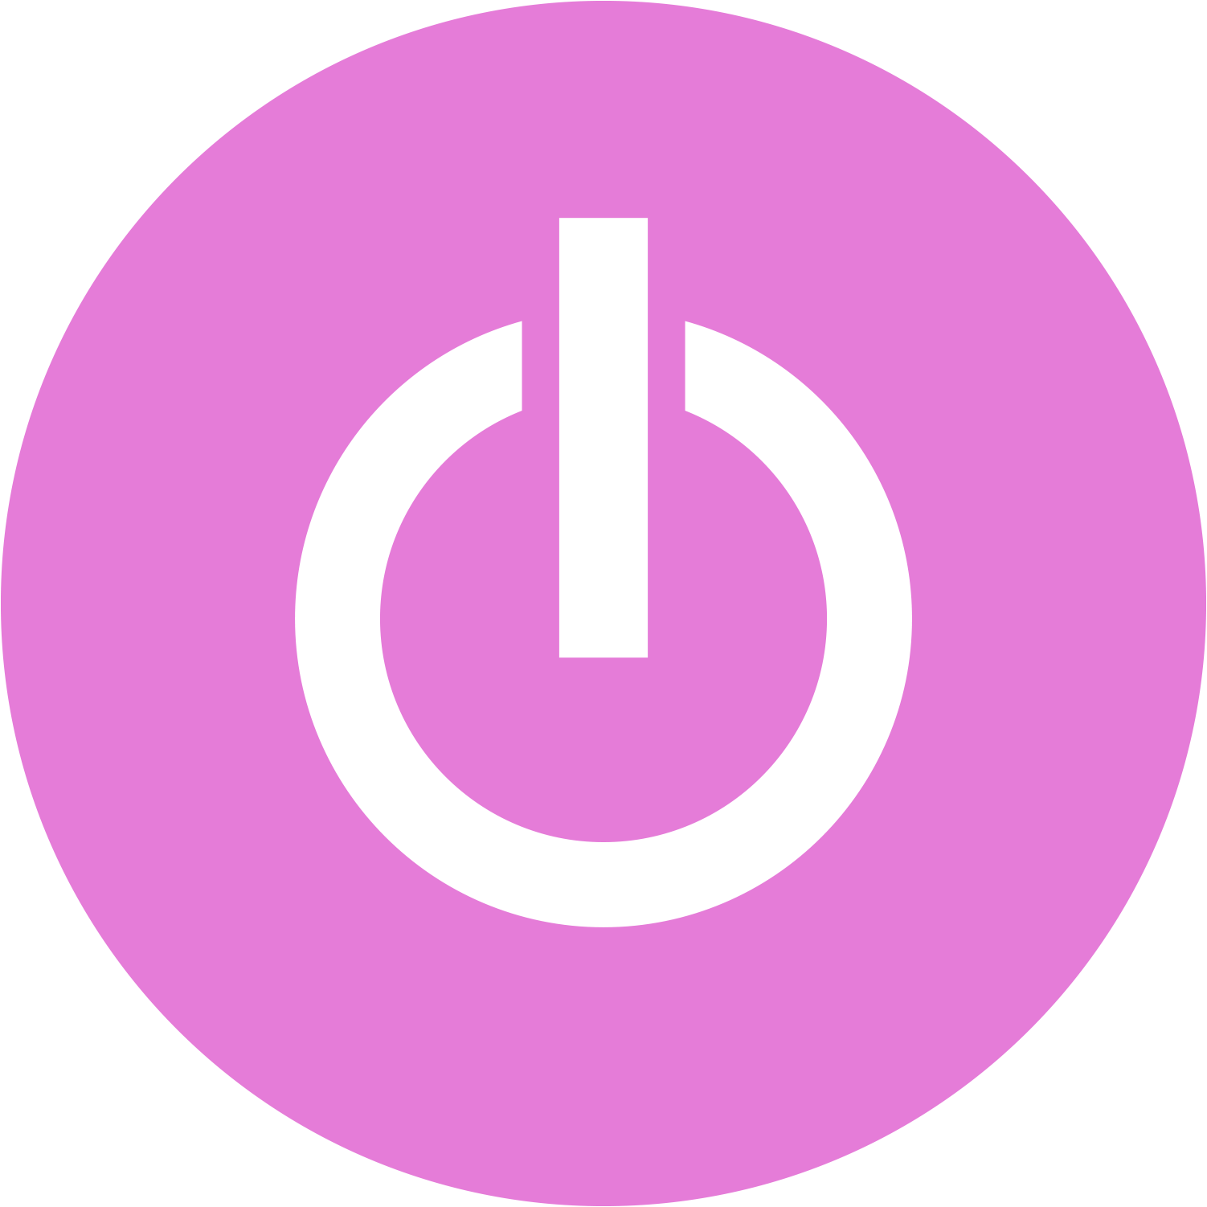
Taking Back Time
It’s not about having to, but wanting to!
IFTTT
Connect your services and devices in a new and remarkable way through applets build for you.
Focus To - Do
Toggle Track
Pomodoro Timer with Task Management that’ll motivate and keep you focused get things done.
Simple time tracker that helps you learn how much your time is worth within one click.
Notes:
IFTTT
IFTTT is a free platform that helps all your products and services work better together.
Connect your services together to create new experiences. Browse the thousands of connections created by the community or make your own.
Services are the apps and devices you use every day. Each service has countless useful and creative ways to connect on IFTTT.
Toggl
Toggl is a triple threat of productivity tools that helps teams do their best work by being:
Do your best work from anywhere
Doing your best work means being the master of your time. Whether from your desk, a cafe, the beach, or a van, we help you maintain your freedom while dominating your to-do list. So, where are we heading next?
Busy ≠ productive
Don't fill your 8 hours for the sake of it. Leave the mundane tasks behind and get more done in less time by focusing on what really matters.
Focus To - Do
Focus To-Do is an easy-to-use time and task management application that helps you to manage tasks anywhere and anytime, and helps you to perform tasks efficiently. Millions of users around the world use our application and have gained efficiency.
Based on the Pomodoro Technique
Set an execution time for the task, focus on the task until the end of the time, the harvest is not only efficiency, but also the unexpected sense of accomplishment.
Whether you are on a mobile phone, a computer or a tablet, you can record tasks or start a Pomodoro at anytime or anywhere.

Slide 9
Notes, Lists, and Habits
You can only know what you make.
Idea Recycling
Keeping Momentum
Information Packets
Abundance
Notes:
Note Taking / Learning:
Spacing
Testing yourself in the same session over and over again will eventually result in better performance over that short period of time.
What’s more important though is the spacing between intervals of tests where you build a better sense of “has this information actually stuck”
Allowing yourself to have a chance to forget some of the information before you re-study (testing yourselves)
Forgetting Curve
Over time our memory just decays.
Testing
The single greatest thing you can do to increase your odds in school on a test.
Testing yourself x1 is better than re-reading the material x4
The more you test yourself, the more likely you are to remember/learn content.
Integral to learning in the first place.
Test yourself before you’ve even had a chance to study. It would help mitigate the confidence bias of thinking you know X, Y, Z, going into the exercise.
Categorising / Building Associations
If we want to learn large amounts of information try to build categorization systems for that information, try and build a structure around it all, rather than just trying to learn.
Idea Recycling
Ideas are not single use
You can reuse them over time if we’re diligently keeping track of all the stuff we’re creating, ideas we’re utilizing for certain projects, because we can simply reuse those ideas and leverage smart work ethic.
Whenever I write a thought paper, an essay, how-to instruction tutorial,
Building blocks can only grow for the better and provide you with a library of tools in which you can build out many other things out of.
Take for example we’re tasked with writing a proposal for a research topic in university/college. We can foresee this won’t be a one time occurrence, or even if it was, we must believe there could be some recycling of this content in the future. We go through the motions of outlining the topic, doing the investigating, providing evidence that supports a justified hypothesis -- this could be enormously beneficial for a new student and only grow with additions over the years from recycling. The topic might change but the formatting and discipline of preparation and execution will save our future selves a lot of work.
You only know what you make
We can read, listen, and watch all the stuff we want but really the stuff we’re going to recognize, interalize, and feasible use in future projects, it’ll be things we’ve created ourselves.
Whether that’s reading a book or listening to a podcast and writing quick summaries of them-- or having having a vision, turning it into an intermediate packet and chucking it into our second brain, when we engage with the material ourselves rather than relying on pre-existing material, we end up becoming much more familiar with it and can do interesting, creative, original whatever things with that stuff.
Biggest regrets in life is that I haven’t taken as many notes, journaled, or captured many of my ideas/habits over the years until later in my undergrad.
I really wish I was doing this from when I was a child first dabbling in science fiction and video games -- there’s an infinite amount of insights or interesting things I could’ve come up with about absolutely everything that could be delightful coming into my journey today.
To Do Lists:
Whether its water consumption or exercise, we can learn to keep ourselves a little more accountable. It hit home significantly when I began university and had to work on projects and find time to approach new and exciting hoobies on the side. The most basic format is to get a calendar and cross off each day you stick with your routine.
For example, if you meditate on Monday, Wednesday, and Friday, each of those dates gets an X. As time rolls by, the calendar becomes a record of your habit streak. I like to use grid paper and make calendars this way and it’s compact because journals can be found to discreetly contain the habit tracker.
Habits:
Whether its water consumption or exercise, we can learn to keep ourselves a little more accountable. It hit home significantly when I began university and had to work on projects and find time to approach new and exciting hoobies on the side. The most basic format is to get a calendar and cross off each day you stick with your routine.
For example, if you meditate on Monday, Wednesday, and Friday, each of those dates gets an X. As time rolls by, the calendar becomes a record of your habit streak. I like to use grid paper and make calendars this way and it’s compact because journals can be found to discreetly contain the habit tracker.
Make it easier for your future self
Putting in the work now will inevitably help your future self.
While right now we’re listening to a podcast or watching something informative and we excitedly write down a note on the topic but don’t expand on the thought too much (or at all).
We posit too much on our future selves to understand what present selves were thinking so we can do a lot more and diligently summarize coherently a thought that can accurately educate our much disconnected future selves to our experience.
With my future self in mind, we are accommodating to a myriad of strenuous cases where we could be deviating from our present selves. We also create a more receptive catalogue of resources whereby the likelihood of someone other than ourselves finding benefit from these cerebral ramblings.
Keep your ideas moving
Anti-perfectionist take on this -- a common trap is that we ought to stay humble and not focus on the intricacies of these apps, services, analog and digital methods for building our knowledge.
The greatest achievement will be production, not the database we house our ideas in.
Unless we are actively doing something with this information, it means nothing without momentum.
Perfect productivity systems mean nothing when we’re not truly producing work (let alone meaningful work).
The ideal system will keep your ideas moving in an imperfect way.
You can improve the system over time, the content is what matters most.

Slide 10
Scheduling and Effective Research
The art of slow burns and remixing knowledge
Batching
Allocate time to do very similar things together. Respond to all emails at the same time, rather than context switching later.
Borrowed Creativity
Managing Deadlines
Working under pressure can produce results but we’d prefer to approach a task over a longer time for assurance.
Capture Habit
Notes:
Scheduling:
Parkinson’s Law -- “Work expands to fill the time we allocate to it.”
Managing Deadlines:
If we have something where the deadline is fast approaching, we tend to allocate more time towards it rather than a task that has a far greater deadline ahead of us.
https://www.timeanddate.com/
Batching:
Scheduling related items to be done together to avoid context switching in the future.
We can produce more work of related content in one batch than if we were to come back to that task much later.
As it’s often said, “it’s easier to keep going than to stop and start up again”
Effective Research
Borrowed Creativity
We all intuitively think of creativity about creating original stuff
I don’t consider myself a creative person because I don’t have truly and real original ideas
Creativity is about remixing knowledge -- things that already exist, (that you read, watch, and listen to) and adding your own spin to them
Combining things in interesting ways
Good artists copy, great artists steal-- key idea that gives us leverage with our second brain is that if you maintain the little bits of all that you watch, read, or listen to, if all of that is organized and in one place, it becomes a lot easier for you to start putting things together and seeing things you wouldn’t have seen before.
You have heard of a wordsmith before, right? No? Well, similar to a blacksmith, they don’t always have to create unique and original items but are masters of manipulating language to produce needed results.
Really exercise your potential by leveraging the resources around you.
Slow Burns
Most of the things that I do are slow burns vs heavy lifts.
Write a report or study for midterm/final exams = Heavy Lift
Big thing that you have to do and seemingly all at once
We have this list of projects that we’re working on and they’re all on the = Slow Burn
As I’m working simultaneously on a few projects over time, whenever I have an idea or am inspired by something throughout my day, I contribute that thought to the second brain.
Over time these gradual contributions, these Slow Burns will add up and infinitely prove valuable to the project's outcome.
We will learn to reduce the amount of heavy lifts we’re performing and eventually build enough of a portfolio within the Second Brain approach to skillfully recycle and reuse what we compiled in advance.

Slide 11
Pomodoro Technique
Do more and have fun with time management
Choose a task
Set your timer
Something that deserves your undivided attention, big or small.
Give yourself 25 or 50 minutes to steadily focus. Don't worry, break time is just as fun.
Break-Time
Immerse Yourself
Begin putting in some work towards that goal of yours until the timer finishes.
Step back, breathe, and relax. Give yourself 5 or 15 minutes to free your brain.
Notes:
The Pomodoro Technique has been pioneered for be 25 mins working, 5 minute breaks, but I like to experiment with what tolerances I can manage.
Sometimes I get into this tunnel focus where I’m really productive and 25 minutes might be a little too quick to break since I’m in a really good thought space so I like to double the time spent in working mode by resetting the timer and going again for another 25 while working towards a longer break session (which these days means moving around, hydrating, and decompressing from screen time).

Slide 12
Digital Literacy
Simple
Connected
Mobile
Desktop
Free
Notes:
Show some of the website content for video

Slide 13
Key Indicators
What success looks like for the rest of us
Human Connections
Meaningful impacts are when we work together to find solutions.
Working Smart
Adaptability comes from being able to utilize the tools all around us.
Delivering Results
Maintaining and meeting clear objectives that meet our needs.
Notes:
Often times we may begin to feel a little overwhelmed or that we’re missing the mark. We always need to keep in mind that what looks like success to us, may not be the same for everyone else, and so on.
These are some of the signs I look for when working throughout my life to ensure I’m not burning out or overworking.
We can find comfort in knowing our strengths, weaknesses, and adhering the best we can to bring ourselves to accomplish the most we can each day, week, or year. Primarily we should always prioritize our health and well-being over exhaustion and connect with as many supports where we’re able to create a support network.

Slide 14
Q & A
Let’s share some thoughts and comments!
What kinds of ideas did this bring to mind?
What are your favourite apps?
How do you like to capture ideas?
Are you interested in the paid alternatives?
What is your preferred device?
Do you have some recommendations?
Notes:
We’re opening the floor now for Q&A

